Slide 1
Object Oriented Analysis and Design
Fundamental Use Cases
COMP 3831
Larman: Chapter 6
W2L1 Fundamental Use Cases
COMP 3831 OOA&D

Slide 2
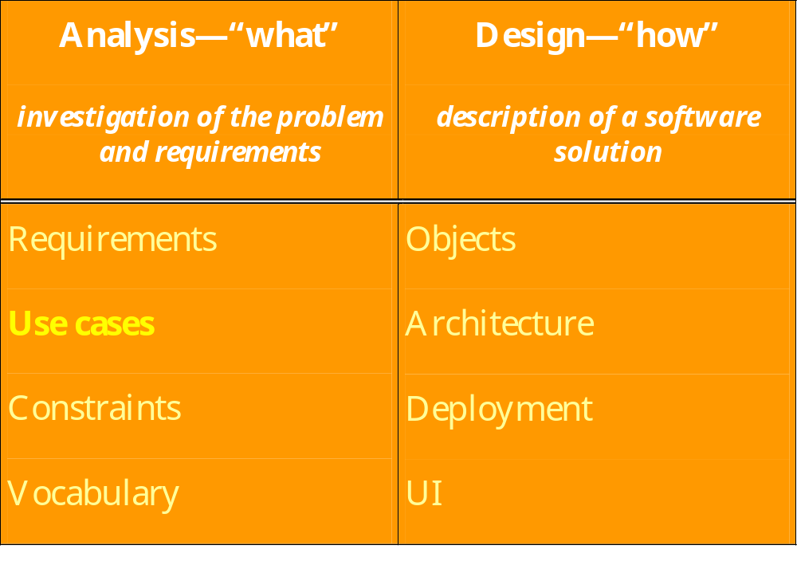
Analysis and Design
Introduced in 1996 by Ivar Jacobson
W2L1 Fundamental Use Cases
COMP 3831 OOA&D

Slide 3
Use Cases
Use cases are requirements that define a promise or contract of how a system will behave.
Focus on the question:
How can using the system provide observable value to the user, or fulfill their goals?
Use cases are text documents, not diagrams. However, UML has notations to illustrate names of use cases and actors.
W2L1 Fundamental Use Cases
COMP 3831 OOA&D

Slide 4
Use Case Definition
A use case is a description of a system's behavior as it responds to a request that originates from outside of that system.
A use case is the smallest unit of activity that is meaningful to the user. A use case must be self-contained and leave the system in a consistent state.
W2L1 Fundamental Use Cases
COMP 3831 OOA&D

Slide 5
Use Case Definition
Mechanism to discover and record requirements
Discovering and recording functional requirements by writing stories of using a system to help fulfill various stakeholder goals
A complete set of use cases for a system encompasses the complete system functionality from users' point of view
Breaking the system down into use cases is an analysis process
W2L1 Fundamental Use Cases
COMP 3831 OOA&D

Slide 6
Use Case Definition provided by RUP
A use case defines a set of use-case instances, where each instance is a sequence of actions a system performs that yields an observable result of value to a particular actor.
A use-case class contains all main, alternate flows of events related to producing the 'observable result of value'.
Technically, a use-case is a class whose instances are scenarios.
W2L1 Fundamental Use Cases
COMP 3831 OOA&D

Slide 7
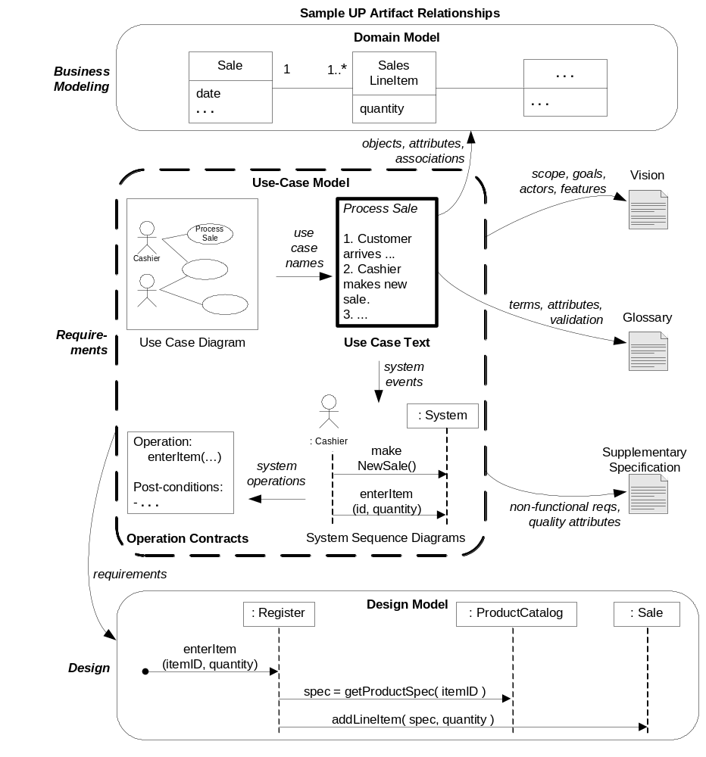
UP Artifacts
W2L1 Fundamental Use Cases
COMP 3831 OOA&D

Slide 8
Other Definitions
Instance
  Occurrence or example
Scenario
  A specific sequence of actions and interactions between actors and the system under discussion
  Also described as a use case instance
  One particular story of using a system or one path through the use case. Examples:
    Successfully purchasing items with cash
    Failing to purchase item after credit card denial
W2L1 Fundamental Use Cases
COMP 3831 OOA&D

Slide 9
Actor
Someone or something, outside the system that interacts with it.
  Person (identified by role)
    Cashier
    Customer ….
  Computer system
  Organization
W2L1 Fundamental Use Cases
COMP 3831 OOA&D

Slide 10
Types of Actors
Primary actor – user goals fulfilled using the system services – cashier
Supporting actor – provides service to the system – automated payment system
Offstage actor – has an interest in the use case – government tax agency
W2L1 Fundamental Use Cases
COMP 3831 OOA&D

Slide 11
Identifying Actors
  Who uses the system?
  Who installs the system?
  Who starts and stops the system?
  Who does user and security management?
  Who maintains the system?
  Who does system administration?
  What other systems use the system?
  Who gets information from the system?
  Who provides information to the system?
  Does anything happen automatically at a preset time?
  Who evaluates system activity or performance?
W2L1 Fundamental Use Cases
COMP 3831 OOA&D

Slide 12
Find System Boundary
Choose system boundary
  If not clear define: What is outside?
Identify primary actors
  Those that have user goals fulfilled through using services of the system
For each primary actor, identify user goals
  Highest user goal level that satisfies EBP guideline
Define use cases that satisfy user goals; name them according to their goal.
W2L1 Fundamental Use Cases
COMP 3831 OOA&D

Slide 13
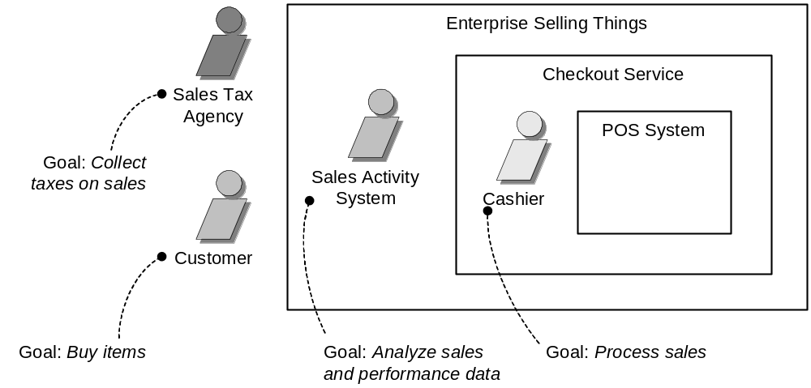
POS System Boundary
W2L1 Fundamental Use Cases
COMP 3831 OOA&D

Slide 14
Identifying Use Cases
What functions will the actor want from the system?
Does the system store information?
What actors will create, read, update or delete information?
Does the system need to notify any actors about its internal state?
Are there any external events the system must know about?
What actor informs the system about these events?
W2L1 Fundamental Use Cases
COMP 3831 OOA&D

Slide 15
EBP Guideline
Focus on use cases at the (E)lementary (B)usiness (P)rocess.
EBP is defines as:
  A task performed by one person in one place in one time, in response to a business event, which adds measurable business value and leaves the data in a consistent state. Example: approve CC.
  It is probably between a few minutes and an hour in length
W2L1 Fundamental Use Cases
COMP 3831 OOA&D

Slide 16
Describing Actors and Use Cases
Each actor has descriptive name and a one or two sentence description
Each use case also needs a descriptive name and a one or two sentence description
Use cases are mostly about text
Don't usually write it all at once
Iterate through several times
W2L1 Fundamental Use Cases
COMP 3831 OOA&D

Slide 17
Actor-Goal list
Actor | Goal |  | Actor | Goal
Cashier | Process sales, process rentals, handle returns, cash in, cash out … |  | System administra-tor | Add users, modify users, delete users, manage security, manage system tables, ….
Manager | Start up, shut down, …. |  | Sales activity system | Analyze sales and performance data ….
W2L1 Fundamental Use Cases
COMP 3831 OOA&D

Slide 18
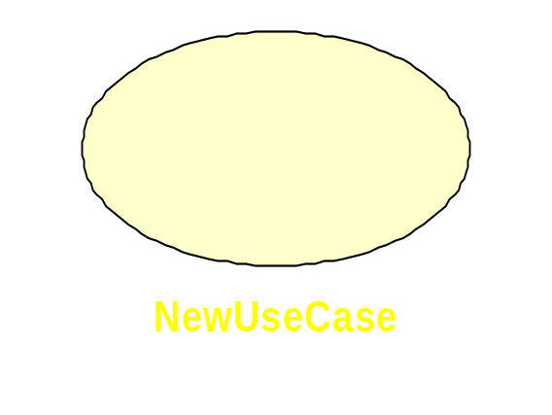
Diagramming Use Cases and Actors
This is an association between an actor and a use case
Stick Man
This is an actor
This is a use case
W2L1 Fundamental Use Cases
COMP 3831 OOA&D

Slide 19
Use case types and formats
Brief: one paragraph summary, usually of the main success scenario
Casual: informal paragraph format. Multiple paragraphs that cover various scenarios
Fully dressed: most elaborate. All steps and variations are written in detail with supporting sections, such as:
  Preconditions
  Success guarantees
W2L1 Fundamental Use Cases
COMP 3831 OOA&D

Slide 20
Brief Format example:
Process Sale: A customer arrives at a checkout with items to purchase. The cashier uses the POS system to record each purchased item. The system presents a running total and line-item details. The customer enters payment information, which the system validates and records. The system updates inventory. The customer receives a receipt from the system and then leaves with the items.
W2L1 Fundamental Use Cases
COMP 3831 OOA&D

Slide 21
Casual Format example:
Handle Returns:
Main Success Scenario: A customer arrives at a checkout with items to return. The cashier uses the POS system to record each returned item. …
Alternate Scenarios:
If they paid by CC, and the reimbursement transaction to their CC account was rejected, inform the customer and pay them with cash.
If the item identifier is not found in the system, notify the cashier and suggest manual entry of the identifier code (perhaps it is corrupted).
If the system detects failure to communicate with the external accounting system, ….
W2L1 Fundamental Use Cases
COMP 3831 OOA&D

Slide 22
Fully dressed example
Elements that make up the fully dressed example are:
  Primary Actor: The principal actor that calls upon system services to fulfill a goal
  Stakeholders and interests: The parties using or affected by the uc
  Preconditions: What must always be true before beginning a scenario in a use case?
  Success Guarantee (post conditions): What must be true on successful completion of a use case?
  Main Success Scenario (or basic flow): describes typical success path (happy path).
  Extensions (or alternative flow): Other success and failure scenarios.
  Special Requirements: a non-functional requirement that specifically relates to a use case (example: touch-screen monitor)
  Technology and data validation list: technical variation on how something must be done. Example: support for CC reader
  Frequency of occurrence
  Open Issues
See example in Craig Larman book: chapter 6, pages 68 to 69.
W2L1 Fundamental Use Cases
COMP 3831 OOA&D

Slide 23
Flow of events Guidelines
Describe how the use case starts and ends
Describe the data exchanged between the actor and the use case
Do not describe the details of the user interface unless is needed to understand the behaviour of the system
Describe the flow of events not only the functionality. To enforce, start every action with “When the actor…”
Describe only the events that belong to the use case and not what happens in other use cases or outside of the system
Avoid vague terminology such as “for example”. “etc” and “information”
Detail the flow of events. All “what’s” should be answered. Remember that test designers will use the use case document to identify test cases.
W2L1 Fundamental Use Cases
COMP 3831 OOA&D

Slide 24
Basic and Alternate Flow of Events
Each use-case has:
  Basic Flow - one normal flow which is the main Success Scenario
  Extensions (alternate flows)
    Extensions - Several alternative flows that can be variants or odd cases
    Exceptions – exceptional flows that handle error situations
W2L1 Fundamental Use Cases
COMP 3831 OOA&D

Slide 25
Extensions (or alternate flows)
Alternate paths through use case and error situations
An extension has two parts:
  the condition
  the handling
If the extension is too complex, express the extension as a separate use case
W2L1 Fundamental Use Cases
COMP 3831 OOA&D

Slide 26
Identify the Extensions
Work through the primary scenario (PS) and find:
Is there some other action that could take place at a given point in the PS?
Is there something that could go wrong at this point in the PS?
Is there something that could happen at any time during the PS?
W2L1 Fundamental Use Cases
COMP 3831 OOA&D

Slide 27
What are scenarios?
A scenario is one flow of events through a use case
It records:
  An interaction between the actors
  A validation, usually by the system
  A state change by the system – like recording or modifying something
W2L1 Fundamental Use Cases
COMP 3831 OOA&D

Slide 28
Primary Scenario
Have paths through use case just like code
Primary scenario is the path when everything goes according to plan
Indicates how use case begins and ends
By default the steps happen in order
There is an appropriate level of detail
Use case should be read and reread to ensure maximum correctness and completeness
W2L1 Fundamental Use Cases
COMP 3831 OOA&D

Slide 29
More Secondary Scenarios
Start with a name
Document secondary scenarios with significant behavior
Try to minimize the writing
Try to document only differences between flow of events for different scenarios
Don't need to build the whole system in English
W2L1 Fundamental Use Cases
COMP 3831 OOA&D

Slide 30
Questions
W2L1 Fundamental Use Cases
COMP 3831 OOA&D

Slide 31
Use Case Example
Process Sale
W2L1 Fundamental Use Cases
COMP 3831 OOA&D

Slide 32
Process Sale UC
Name: Process Sale
Primary Actor: Cashier
Stakeholders and Interests
  Cashier: wants accurate, fast entry and no payment errors.
Preconditions: Cashier is identified and authenticated
W2L1 Fundamental Use Cases
COMP 3831 OOA&D

Slide 33
Process Sale UC (cont)
Post-conditions:
  Sale is saved
  Tax is correctly calculated
  Accounting and Inventory are updated
  Commissions are recorded
  Receipt is generated
  Payment authorization approvals are recorded
W2L1 Fundamental Use Cases
COMP 3831 OOA&D

Slide 34
Process Sale UC (cont)
Main Success Scenario (BASIC FLOW)
Actor Actions | System Response
1.This use case begins when a customer arrives at POS checkout with goods and/or services to purchase 2. Cashier starts a new sale 3. Cashier enters the item identifier 5. Cashier repeats step 3-4 until indicates done 7. Cashier tells customer the total and ask for payment 8. Customer pays the cashier | 4. System records sale line item and presents item description, price and running total. Price calculated from a set of price rules. 6. System presents total with taxes calculates 9.System logs completed sale 10. System presents receipt
W2L1 Fundamental Use Cases
COMP 3831 OOA&D

Slide 35
Process Sale UC (cont)
Main Success Scenario (BASIC FLOW)
Extensions (Alternative Flows)
Special Requirement
Technology and Data Variations List
Frequency of Occurrence
Open Issues
W2L1 Fundamental Use Cases
COMP 3831 OOA&D

Slide 36
Relating Use Cases
When creating the use case diagram, it can be useful (in terms of comprehension and simplification) to:
  factor out shared sub-processes
    use the <<includes>> relationship
  show precedence order
    use the <<extends>> relationship
W2L1 Fundamental Use Cases
COMP 3831 OOA&D

Slide 37
Extends
Used for an optional sequence of events that can be included in a use case
Can involve adding something to an existing use case
Allows original use case to remain unchanged
Attach at an extension point
Very common software concept
W2L1 Fundamental Use Cases
COMP 3831 OOA&D

Slide 38
Uses or Includes
If the same steps are found in multiple use cases
Abstract the common behavior into a separate new use case
Any use cases that involve these steps just need to reference the new use case
Like abstracting repeated code into a function call
W2L1 Fundamental Use Cases
COMP 3831 OOA&D

Slide 39
Diagramming Uses and Extends Relationships
<<extend>>
User Use Case
Usee or Used Use Case
<<include>>
User Use Case
Usee or Used Use Case
W2L1 Fundamental Use Cases
COMP 3831 OOA&D

Slide 40
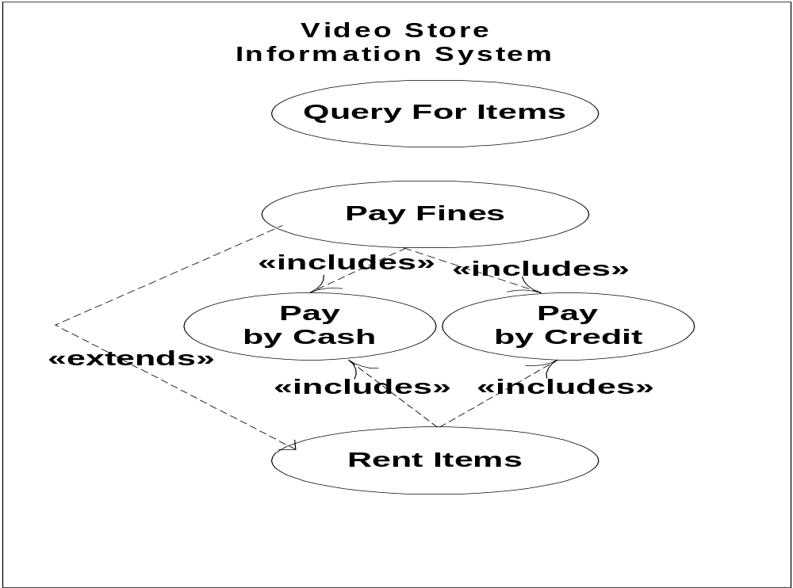
Example of <<include>> & <<extends>>
W2L1 Fundamental Use Cases
COMP 3831 OOA&D

Slide 41
Relationship
The arrow joining the use case in the diagram represents a directional association relationship
Association defined as:
  A relationship that models a bi-directional semantic connection among instances.
  Some sort of meaningful relationship between the associating parties
Directional association goes only one way
With no arrow, it's a 2 way association
W2L1 Fundamental Use Cases
COMP 3831 OOA&D

Slide 42
Stereotypes
The <<extends>> and <<uses>> are called stereotypes
Stereotype defined as
  A meta-classification of an element. Stereotypes have semantic implications which can be specified for every specific stereotype value.
Fancy word for a meaningful name
W2L1 Fundamental Use Cases
COMP 3831 OOA&D

Slide 43
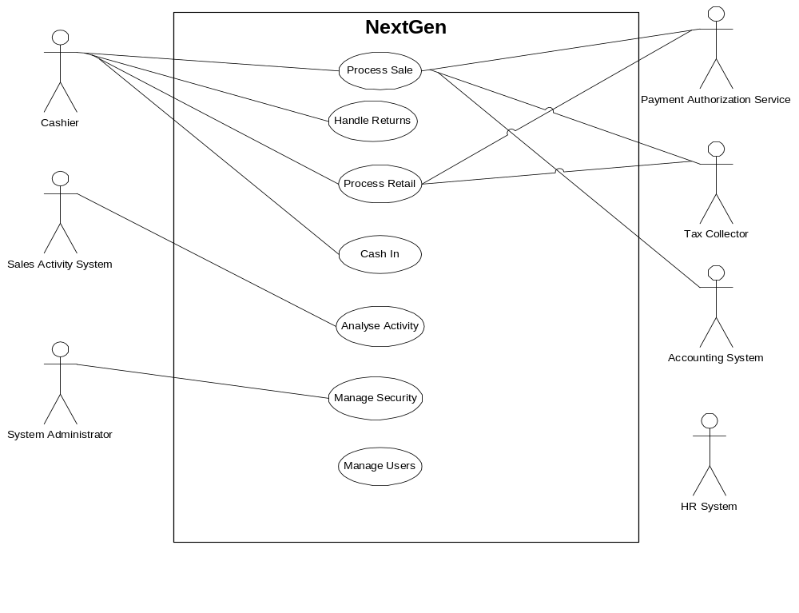
`
Partial use case diagram
System Boundary
Communication
W2L1 Fundamental Use Cases
COMP 3831 OOA&D

Slide 44
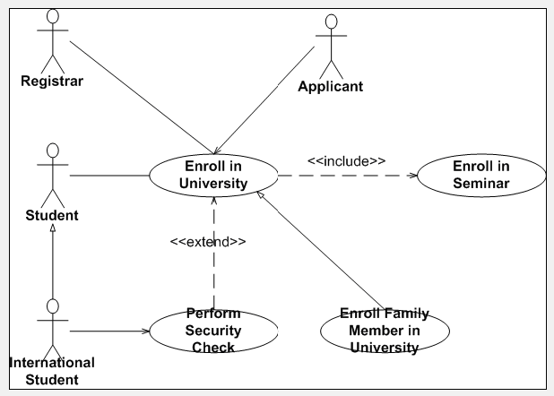
`
Use Case Diagram - Example
W2L1 Fundamental Use Cases
COMP 3831 OOA&D

Slide 45
Questions and Conclusions
W2L1 Fundamental Use Cases
COMP 3831 OOA&D

